Slide 1
SITUATIONAL REPORT
ST. JOSEPH HOSPITAL, JIRAPA
SEPTEMBER 2023

Slide 2
Hospital Health information
PERIOD UNDER REVIEW:
(HOSPITAL HALF-YEAR REVIEW) january 2023 – june 2023

Slide 3
Trend OPD Attendance

Slide 4
Top 10 OPD Morbidity for 2023 Half Year

Slide 5
Bed state Utilization
Indicator | 2017 | 2018 | 2019 | 2020 | 2021 | 2022 | 2023
Beds | 193 | 193 | 206 | 206 | 206 | 188 | 188
Admissions | 7,303 | 4,861 | 5,303 | 4,422 | 4,731 | 4,484 | 4,808
Discharges | 7,096 | 4,747 | 5,054 | 4,307 | 4,500 | 4,396 | 4,665
Death | 156 | 108 | 131 | 109 | 94 | 93 | 89
Death Rate | 2.1% | 2.2% | 2.5% | 2.5% | 2.0% | 2.1% | 1.9%
Av. Length of Stay | 3.7 | 3.6 | 3.6 | 3.9 | 3.5 | 3.2 | 3.4
Average Daily Occupancy | 149 | 95 | 103 | 95 | 88 | 78 | 89
%Occupancy | 77.2 | 49.4 | 49.8 | 46.2 | 42.8 | 41.6 | 47.3

Slide 6
Surgeries

Slide 7
Referrals

Slide 8
Attendance of Specialist Clinics

Slide 9
LABORATORY
 | 2019 | 2020 | 2021 | 2022 | 2023
Total Attendance | 18,965 | 13,742 | 14,238 | 12,449 | 13,062
Total Test Done | 57,895 | 42,236 | 43,714 | 46,659 | 29,904
Average Test | 3.1 | 3.1 | 3.1 | 3.7 | 2.3

Slide 10
X-ray performance
Indicator | 2019 | 2020 | 2021 | 2022 | 2023
No of X-rays taken | 1,049 | 1,156 | 620 | 899 | 1,090
No of Children | 133 | 145 | 105 | 101 | 126
No of Adults | 852 | 926 | 435 | 612 | 788
Total No. of Patients | 985 | 1,071 | 540 | 713 | 914

Slide 11
Trend of Ultrasound Utilization

Slide 12
Trend of ANC Registration

Slide 14
IPT Administration
Indicator | 2019 | 2020 | 2021 | 2022 | 2023
ANC Registrants | 290 | 318 | 292 | 266 | 243
IPT1 | 215 | 219 | 200 | 200 | 147
IPT2 | 197 | 242 | 198 | 202 | 159
IPT3 | 223 | 253 | 201 | 198 | 152
IPT4 | 201 | 235 | 173 | 171 | 148
IPT5 | 211 | 187 | 122 | 129 | 98

Slide 15
Supervised Deliveries
SELECTED INDICATORS | 2017 | 2018 | 2019 | 2020 | 2021 | 2022 | 2023
Total Deliveries | 832 | 739 | 725 | 799 | 886 | 830 | 777
Normal Deliveries | 635 | 581 | 547 | 553 | 657 | 627 | 560
Caesarean Section (C/S) Delivery | 149 | 95 | 124 | 170 | 200 | 173 | 217
Vacuum Extraction | 48 | 63 | 54 | 75 | 29 | 36 | 15
Total Live Births | 842 | 748 | 725 | 805 | 904 | 839 | 807
No. of Fresh Still Births | 6 | 12 | 4 | 11 | 0 | 3 | 2
No. of Macerated Still Births | 3 | 4 | 12 | 7 | 1 | 4 | 0
Total Still Births | 9 | 16 | 16 | 18 | 1 | 7 | 2
No. of Still births Audited | 0 | 16 | 16 | 18 | 1 | 7 | 2

Slide 16
Trend of C/S Rate

Slide 17
Maternal and Neonatal Mortalities
INDICATORS | 2017 | 2018 | 2019 | 2020 | 2021 | 2022 | 2023
No. of Neonatal Deaths | 11 | 10 | 22 | 14 | 6 | 1 | 1
NND Rate/1000LBS | 13 | 13 | 30.3 | 17.4 | 6.6 | 1.2 | 1.2
Maternal Deaths | 2 | 0 | 0 | 0 | 0 | 0 | 0
Maternal Deaths Audit | 2 | 0 | 0 | 0 | 0 | 0 | 0
MMR/100000LBs | 238 | 0 | 0 | 0 | 0 | 0 | 0

Slide 18
Abortions
Type of Abortions | 2019 | 2020 | 2021 | 2022 | 2023
Elective | 0 | 0 | 0 | 0 | 0
Spontaneous | 84 | 69 | 46 | 78 | 92
Induced | 15 | 13 | 0 | 16 | 10
Total | 99 | 82 | 46 | 94 | 102
MVA | 74 | 45 | 46 | 87 | 89

Slide 19
Disease Surveillance
Disease Surveillance
Condition | 2020 |  | 2021 |  | 2022 |  | 2023
 | Suspected | Confirmed | Suspected | Confirmed | Suspected | Confirmed | Suspected | Confirmed
COVID 19 | 17 | 0 | 124 | 12 | 19 | 3 | 24 | 2
AFP | 2 | 0 | 1 | 0 | 1 | 0 | 0 | 0
Cholera | 0 | 0 | 0 | 0 | 0 | 0 | 0 | 0
Measles | 0 | 0 | 0 | 0 | 0 | 0 | 0 | 0
Yellow Fever | 3 | 0 | 0 | 0 | 1 | 0 | 0 | 0
Meningitis | 71 | 24 | 10 | 0 | 17 | 2 | 13 | 1
Rabies | 0 | 0 | 0 | 0 | 0 | 0 | 0 | 0
Guinea Worm | 0 | 0 | 0 | 0 | 0 | 0 | 0 | 0
Neonatal Tetanus | 0 | 0 | 0 | 0 | 0 | 0 | 0 | 0
AEFI | 0 |  | 0 |  | 0 |  | 0

Slide 20
HIV Performance
Indicator |  | 2019 | 2020 | 2021 | 2022 | 2023
HTC | Tested | 312 | 309 | 398 | 199 | 352
 | Positive | 27 | 26 | 37 | 25 | 24
PMTCT | Tested | 265 | 318 | 292 | 266 | 196
 | Positive | 0 | 0 | 3 | 1 | 3
Total | Tested | 577 | 627 | 690 | 465 | 548
 | Positive | 27 | 26 | 37 | 25 | 27

Slide 21
UPDATE ON HOSPITAL STATE
PERIOD UNDER REVIEW:
JULY 2023 – SEPTEMBER 2023

Slide 22
Major Concerns: AT MID-YEAR 2023
Decrease hospital mortality rate and improve clinical and public health indicators
Provision of modern medical equipment (IGF, Philanthropists, Project cure)
Inception of operational theatre recovery room
Rewiring and earthing of electrical system to prevent frequent breakdown of equipment and gadgets
Mental ward and rehabilitation centre – Implementation
Outsourcing of hospital canteen
Grants from LOLA GROUP - Staff accommodation, Solar plant, Vehicles (2), Oxygen plant, Emergency unit, Laundry, Administration block
Procurement of Hb Electrophoresis machines for laboratory
Procurement of ECG machine for Emergency ward/OPD
Renovation of mothers’ hostel
Expansion of staff medical subsidy policy (Spouses)
Provision of Obstetrics/Gynaecology theatre at maternity ward
Solar lamps for wards
Annual staff health screening (217 Staff)
Staff in-service training
Solar energy backup system (50,000 – 80,000 cedis per ward)
Barcoded patient ID cards
Inception of OPD special clinic days
End of year staff awards

Slide 23
Major Activities Carried Out
Weekly clinical meetings, NND audits and monthly mortality conferences
Health education ongoing twice weekly on Radio Gangaa
Second quarter staff durbar
Acquisition of new medical equipment
Third quarter voluntary blood donation exercise
Staff identification – nametags (79 new)
Mental ward and rehab implementation (OPD and IPD)
NITA wireless internet connection
Peer visit to St. Theresa Hospital, Nandom
Annual leadership workshop (maiden)
Specialty units community outreach – School health screening
Half-year performance review
Annual staff health screening

Slide 24
HUMAN RESOURCE
CATEGORY | CHAG | GHS | CASUALS | TOTAL
Medical Officers | 1 | 4 | 0 | 5
Physician Assistants | 5 | 0 | 8 | 13
Community Nurses | 19 | 0 | 0 | 19
Registered General Nurses | 56 | 28 | 11 | 95
Midwives | 26 | 32 | 4 | 62
Enrolled Nurses | 63 | 22 | 0 | 85
Allied Health | 20 | 17 | 4 | 41
Admin & Support staff | 42 | 1 | 1 | 44
Pharmacy – Pharmacist Technicians, MCAs | 1 | 1 | 7 | 9
Other Staff | 0 | 0 | 60 | 59
Total | 234 | 104 | 94 | 432
STUDY LEAVE – 60 (CHAG-39, GHS-21); NSP – 53

Slide 25
MATRON 360 REPORT
WARDS | MARKS | POSITION | UNITS | MARKS | POSITION | DEPARTMENT | MARKS | POSITION
SURGICAL | 70.3 | 8TH | THEATRE | 51.3 | 2ND | ADMINISTRATION | 35.3 | 6TH
FEMALE MED. | 83.3 | 2ND | DENTAL | 38.7 | 7TH | RECORDS | 42.0 | 4TH
MALE MED. | 77.3 | 4TH | EYE/ENT | 39.7 | 6TH | PHARMACY | 39.7 | 5TH
GENERAL | 75.0 | 6TH | ANC | 51.7 | 1ST | SECURITY | 16.0 | 9TH
CHILDREN | 72.3 | 7TH | MENTAL | 35.3 | 8TH | LABORATORY | 45.3 | 2ND
MATERNITY | 78.3 | 3RD | PHU | 49.0 | 3RD | X-RAY | 35.3 | 6TH
NICU | 88.6 | 1ST | VCT | 48.0 | 4TH | OPD | 46.3 | 1ST
EMERGENCY | 76.6 | 5TH | PHYSIO | 44.7 | 5TH | STORES | 30.0 | 8TH
 |  |  | KITCHEN | 31.0 | 10TH | MORTUARY | 42.3 | 3RD
 |  |  | LAUNDRY | 33.0 | 9TH | MAINTENANCE | 16.0 | 9TH

Slide 26
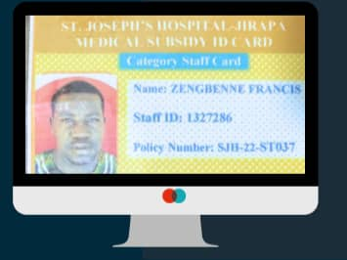
STAFF MEDICAL SUBSIDY POLICY

Slide 27
CHALLENGES - 1
Financial challenges
  Delay in NHIS reimbursement
  High NHIS deductions
  Low IGF generation
  Increased cost of supplies and unfavourable payment terms
  Absence of Internal auditor and Audit committee
Infrastructural challenges
  Uncompleted Administration block
  Lack of accommodation for critical staff
  Limited space at NICU, labour ward and mortuary
  Proposed theatre at Maternity (not yet done)
  Uncompleted road and gutter construction

Slide 28
CHALLENGES - 2
Human resource challenges
  Inadequate number of specialists eg. Surgeon, Paediatrician, Obstetrician/Gynaecologist, Nurse specialists
  Increased number of casuals and payroll issues
  Staff attrition
Other challenges
  Payment of electricity bills
  Inadequate spacing (Emergency unit, Public health unit etc)

Slide 29
ACHIEVEMENTS
Twice weekly radio health talks
Mental ward and rehab center – Implementation
2 staff received presidential COVID-19 award
Improvement in equipment - Ultrasound machines etc.
Peer visit to St. Theresa Hospital, Nandom
Annual leadership workshop
Hospital tenancy association initiation
Inception of operational theatre recovery room
Annual staff health screening
Maiden edition of hospital magazine
Outsourcing of hospital canteen
Inception of bar-coded patient ID card
Acquisition of Hb Electrophoresis machine

Slide 30
WAY FORWARD - 1
Renovation of NICU mothers’ hostel (ongoing)
Grants from LOLA GROUP - Staff accommodation, Solar plant, Vehicles (2), Oxygen plant, Emergency unit, Laundry, Administration block (ongoing)
German Urologists visit in October 2023
Inception of Hb Electrophoresis and coagulation tests at laboratory
Family health conference in second half of 2023
Input of casual staff into controller payroll
Introduction of special clinics days at OPD
Procurement of ECG machine for Emergency ward/OPD

Slide 31
WAY FORWARD - 2
Conversion of current conference room at maternity into Obstetrics and Gynaecology theatre
Completion of electrical rewiring and earthing of hospital infrastructure
Provision of sheds for patient relatives
Extension of CCTV cameras to stores
Acquisition of modern medical equipment
Continue lobby with Regional minister, MOH, MCE & MP to complete new administration block, hospital road and gutter construction
End of year staff awards

Slide 32
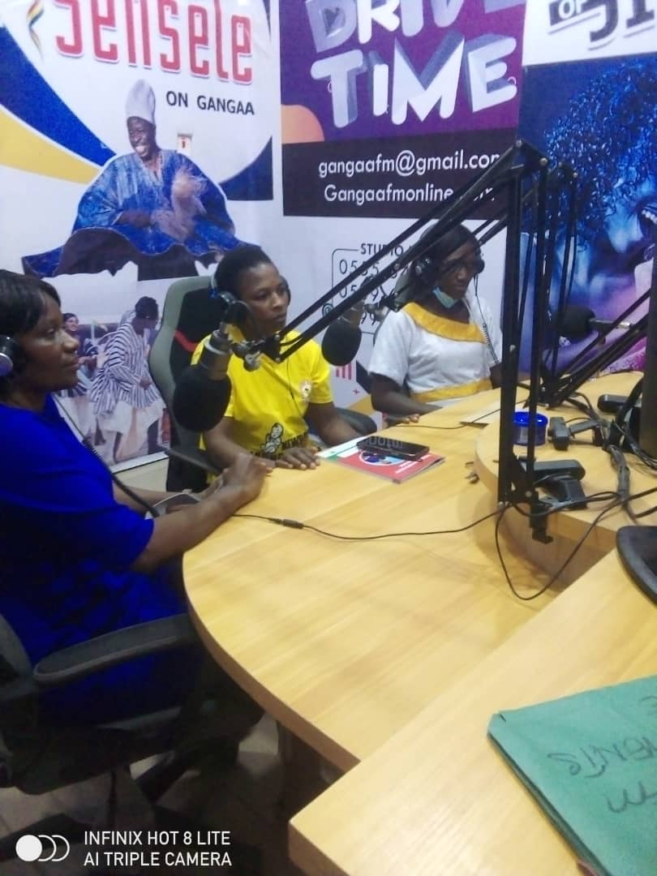
TWICE WEEKLY HEALTH TALKS AT RADIO GANGAA

Slide 33
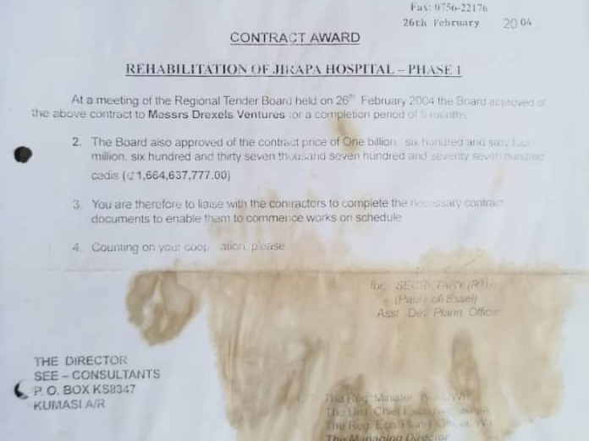
NEW ADMINISTRATION BLOCK – CONTRACT DOCUMENT

Slide 34
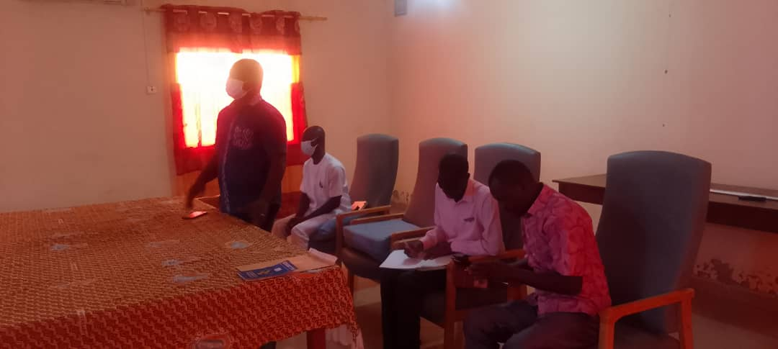
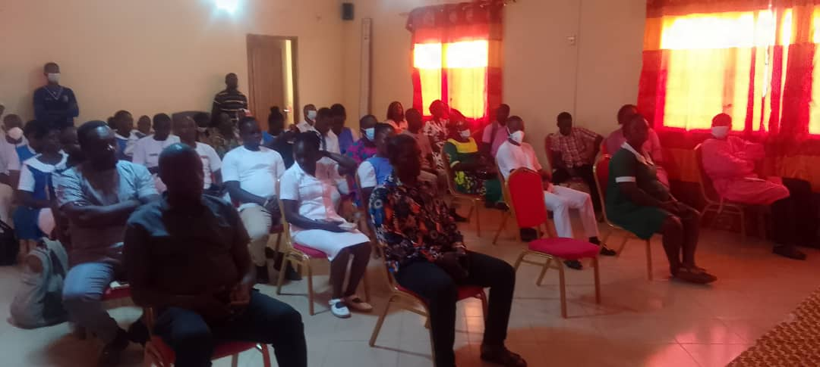
PEER VISIT TO ST. THERESA HOSPITAL, NANDOM

Slide 35
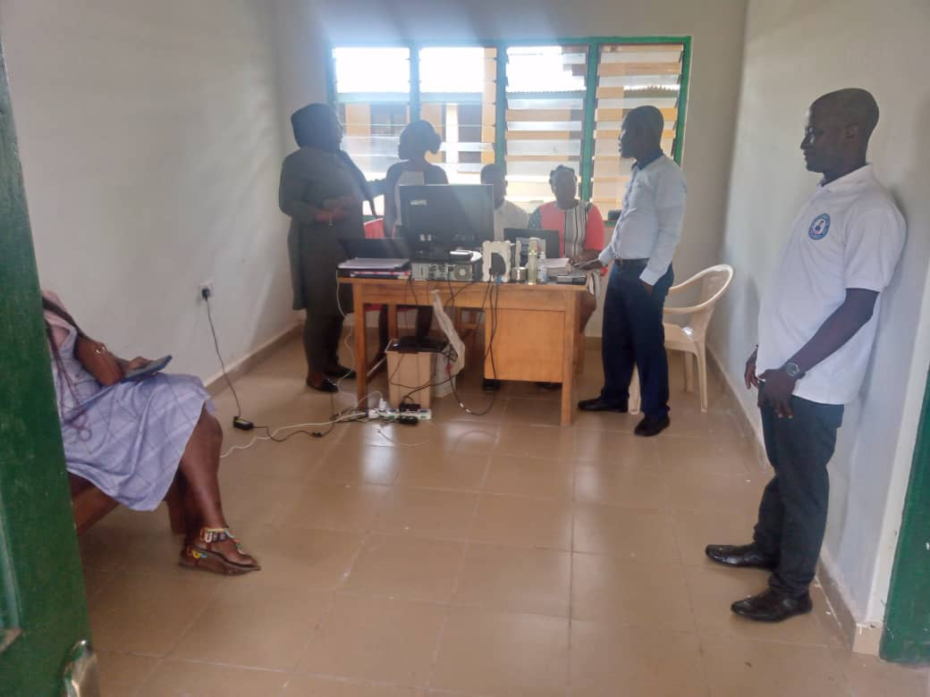
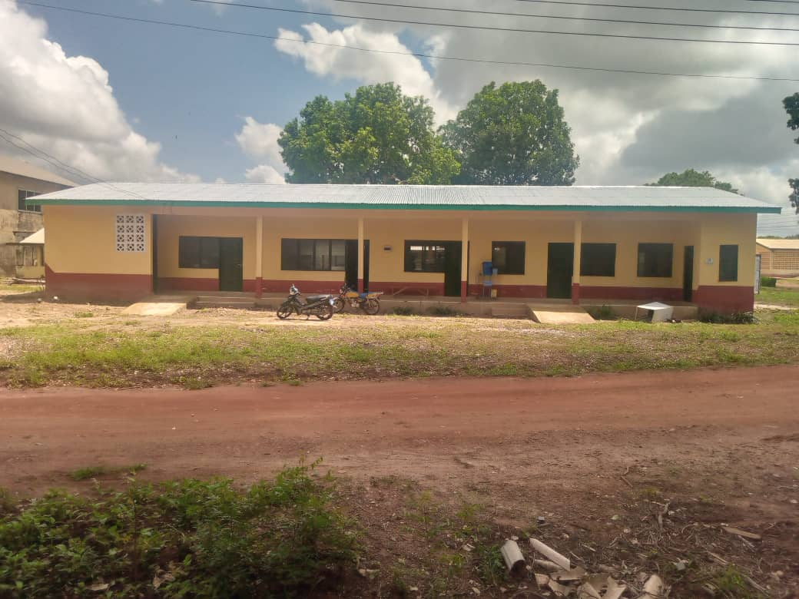
MENTAL WARD/REHAB IMPLEMENTATION

Slide 36
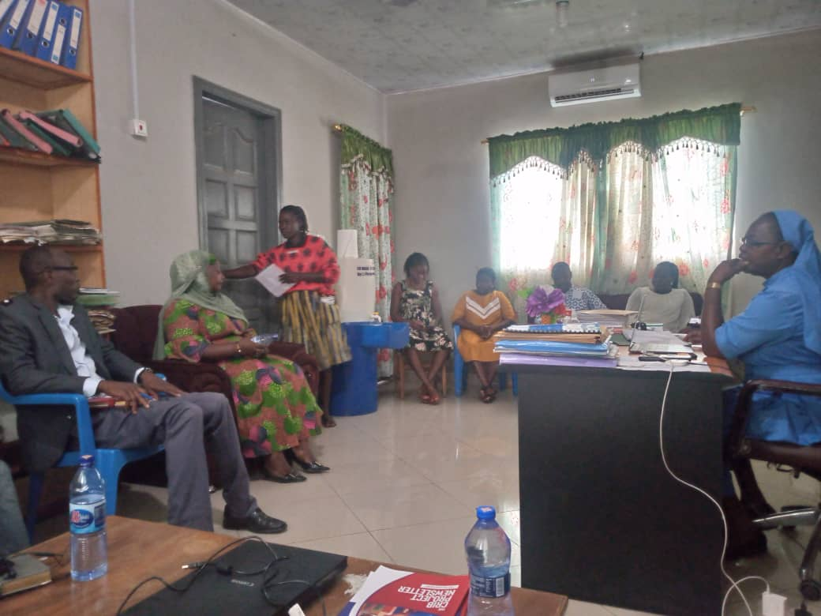
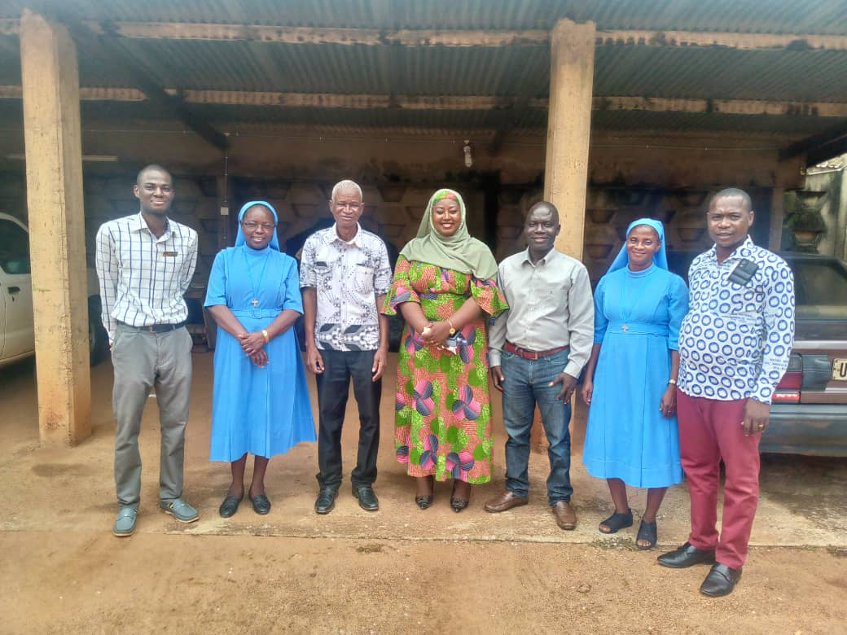
MENTAL WARD/REHAB IMPLEMENTATION

Slide 37
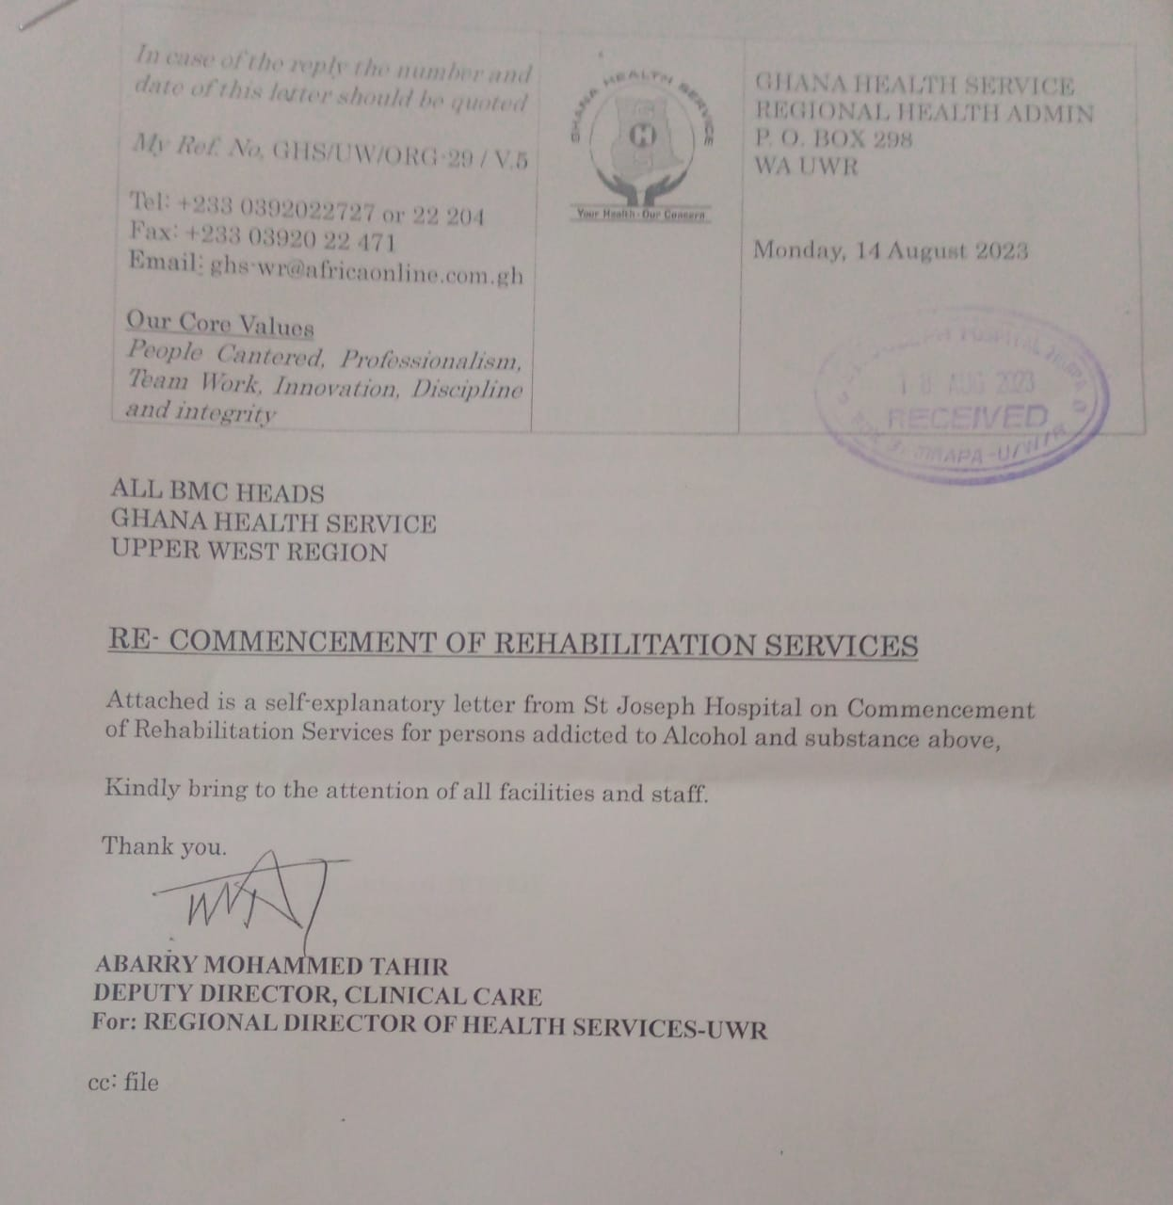
REHAB COMMENCEMENT

Slide 38
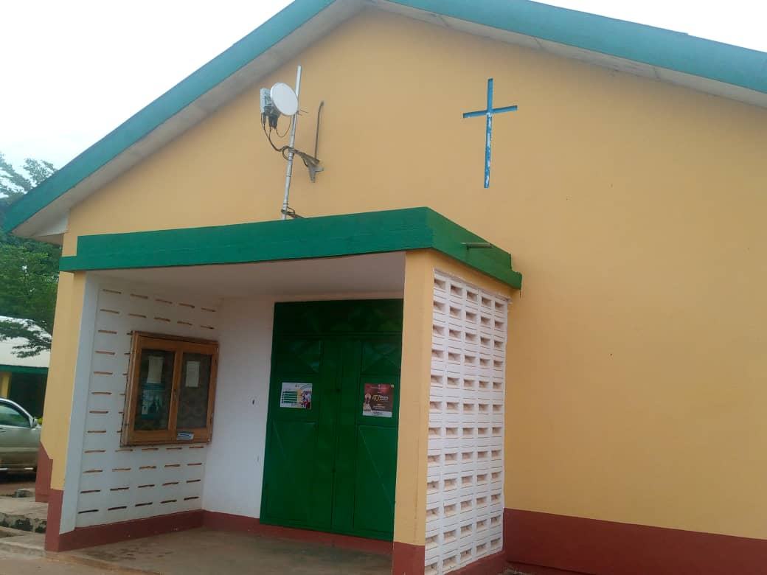
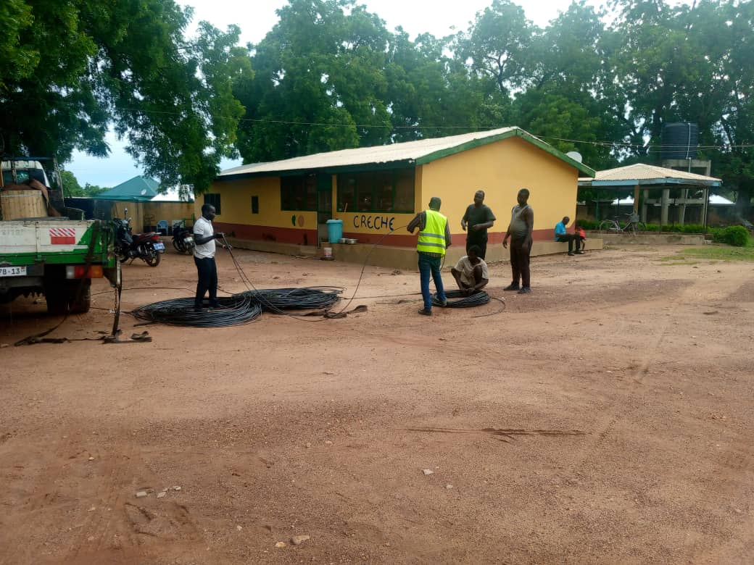
NITA WIRELESS INTERNET CONNECTION

Slide 39
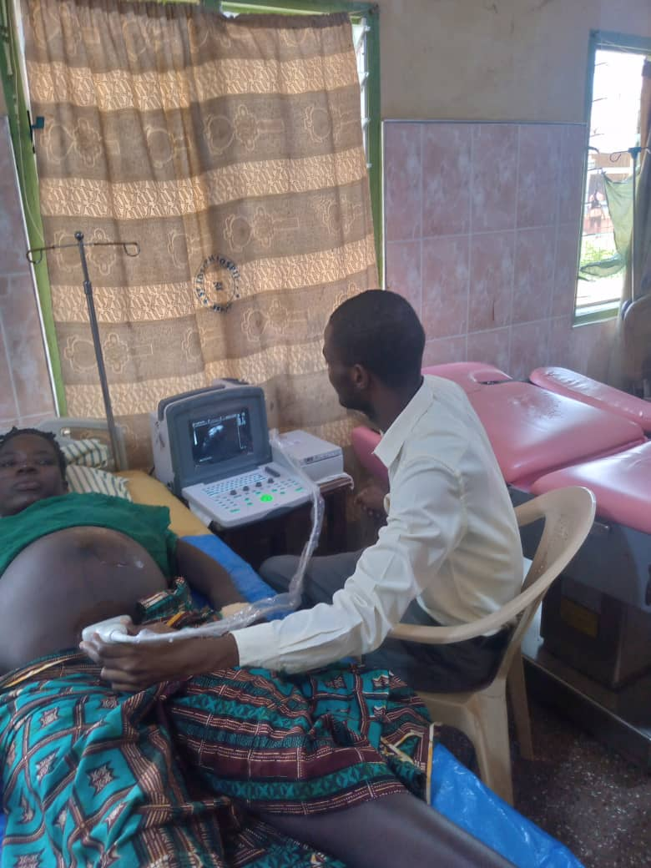
NEW PORTABLE ULTRASOUND MACHINE

Slide 40
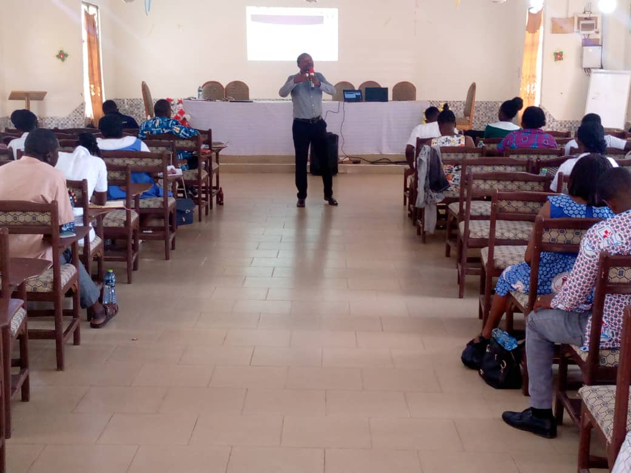
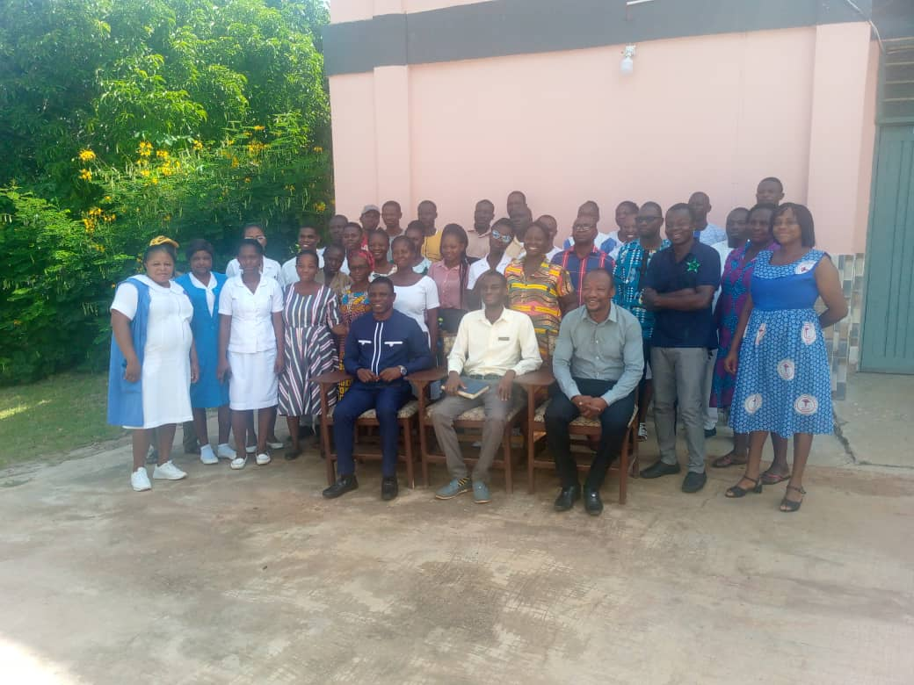
ANNUAL LEADERSHIP RETREAT

Slide 41
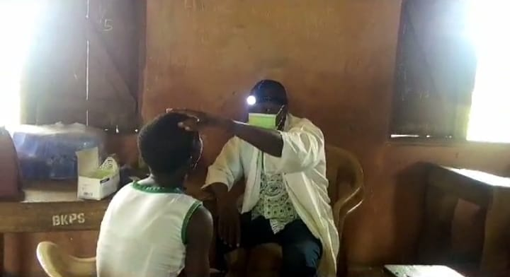
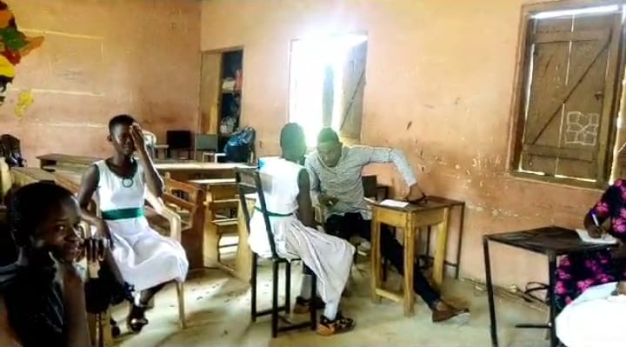
SCHOOL HEALTH SCREENING – ST. JOSEPH JHS

Slide 42
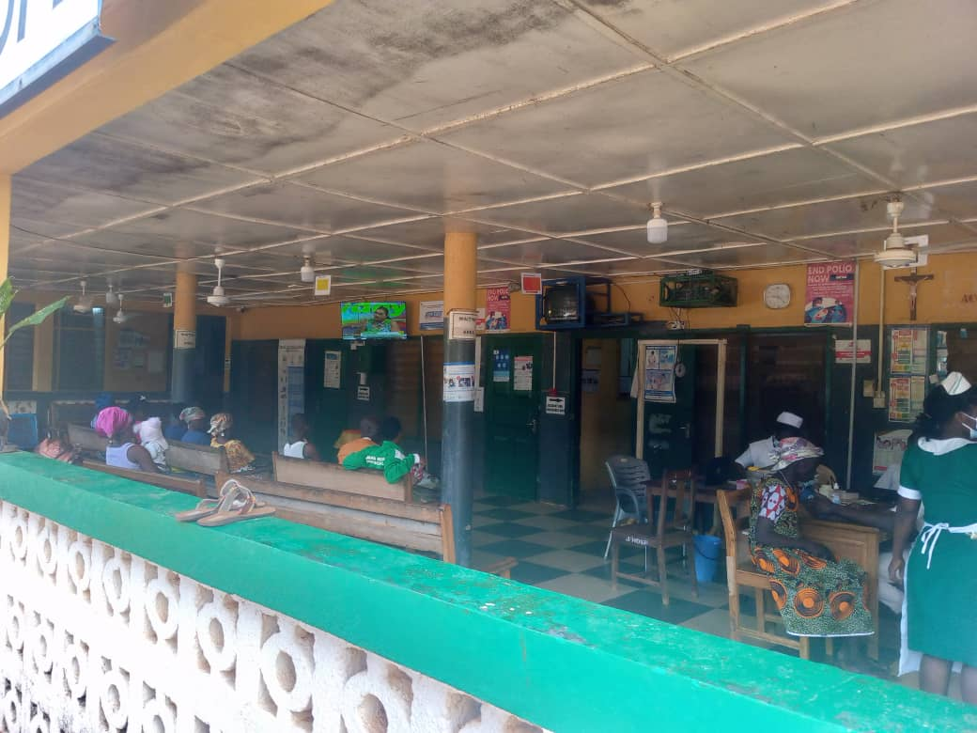
DONATION FROM CEO OF ROYAL COSY RESORT – MR. ERIC JOHNSON

Slide 43
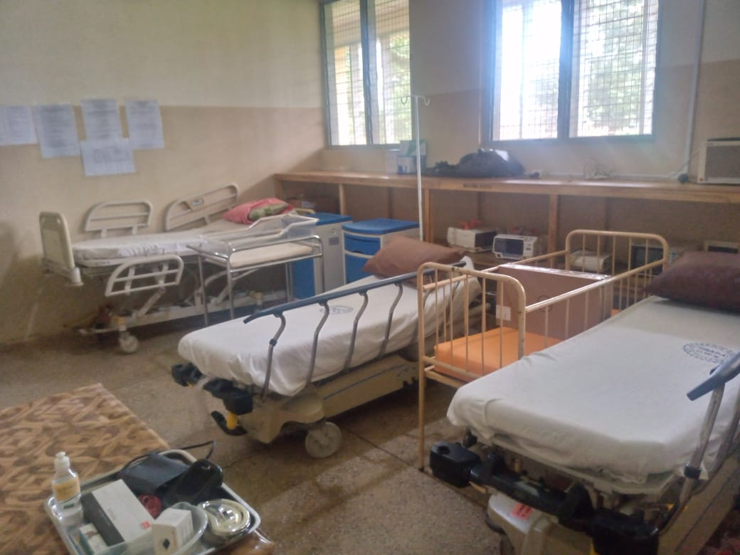
THEATRE RECOVERY ROOM

Slide 44
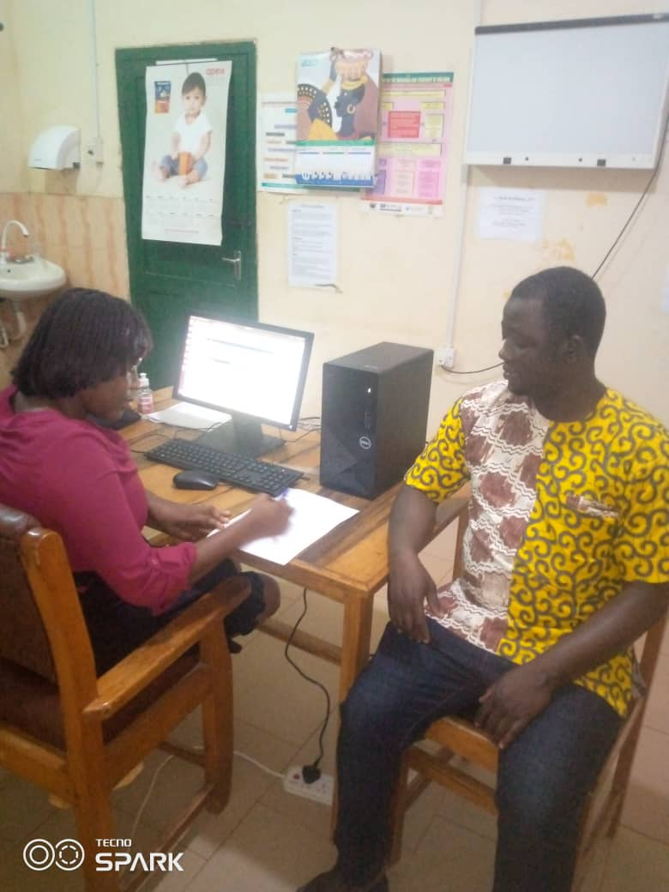
ANNUAL STAFF HEALTH SCREENING

Slide 45
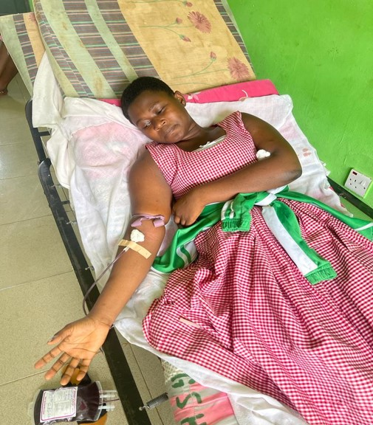
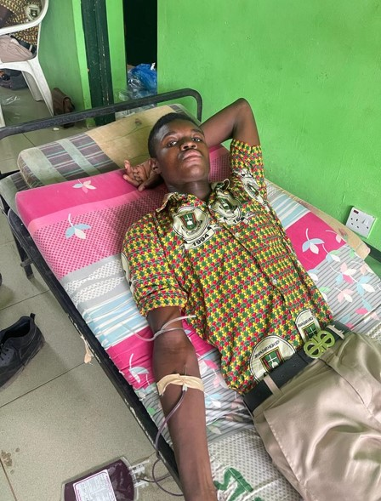
THIRD QUARTER BLOOD DONATION EXERCISE

Slide 46
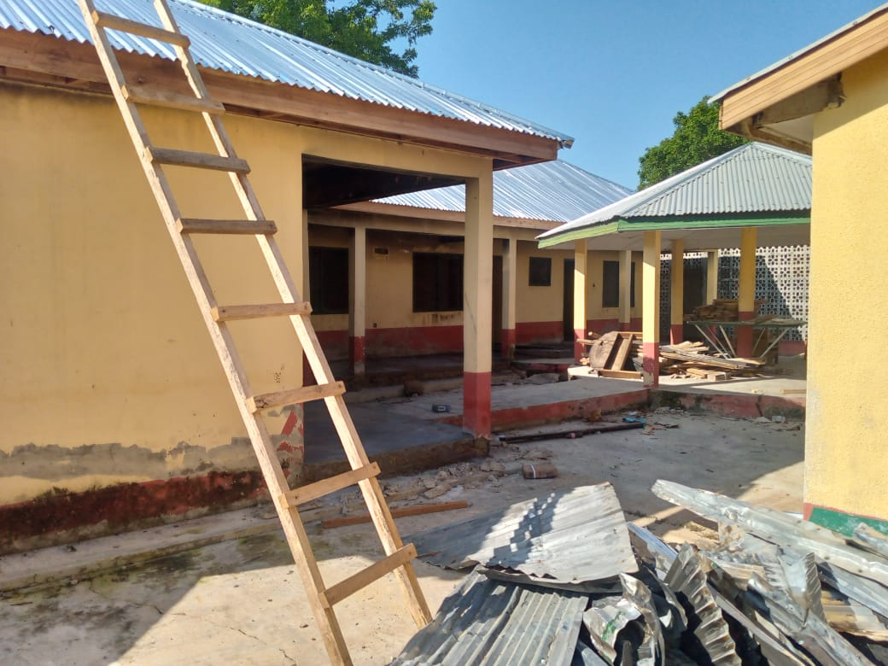
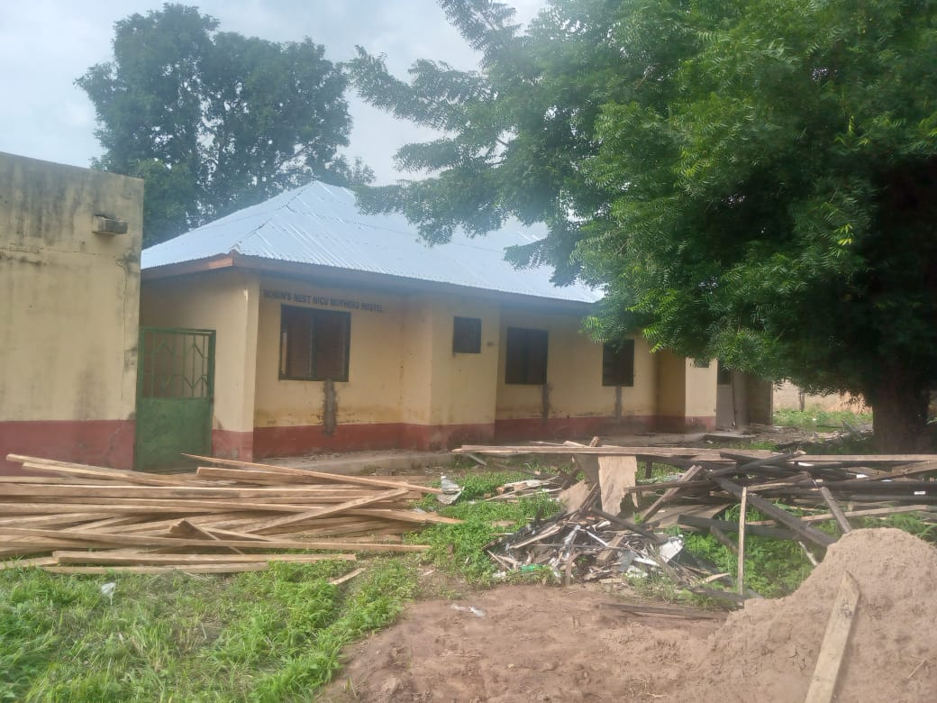
RENOVATION OF NICU MOTHERS’ HOSTEL

Slide 47
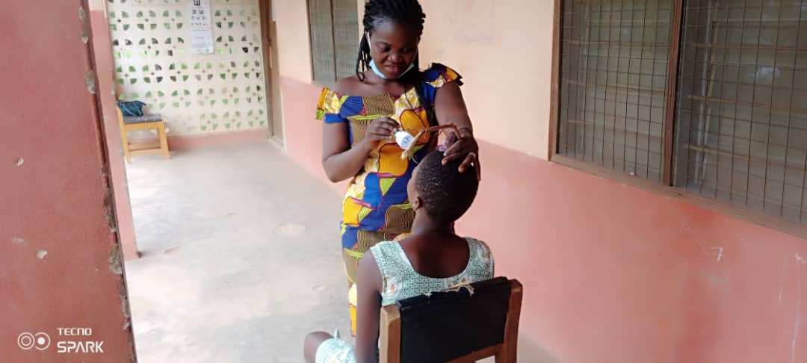
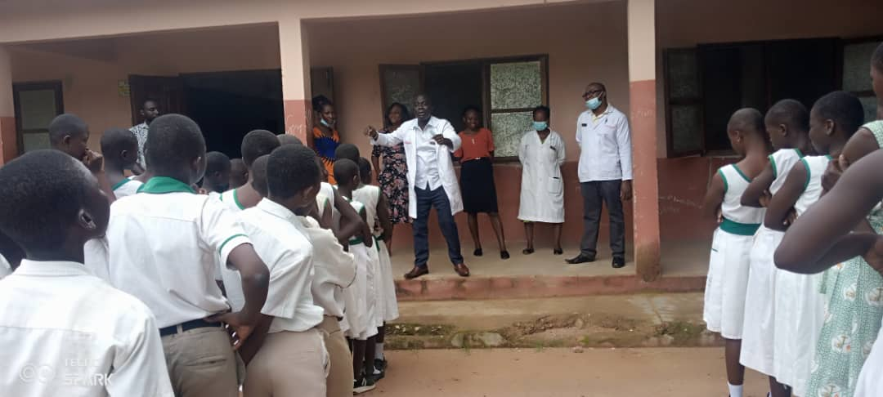
SCHOOL HEALTH SCREENING – ST. AGNES JHS

Slide 48

HOSPITAL MAGAZINE

Slide 49
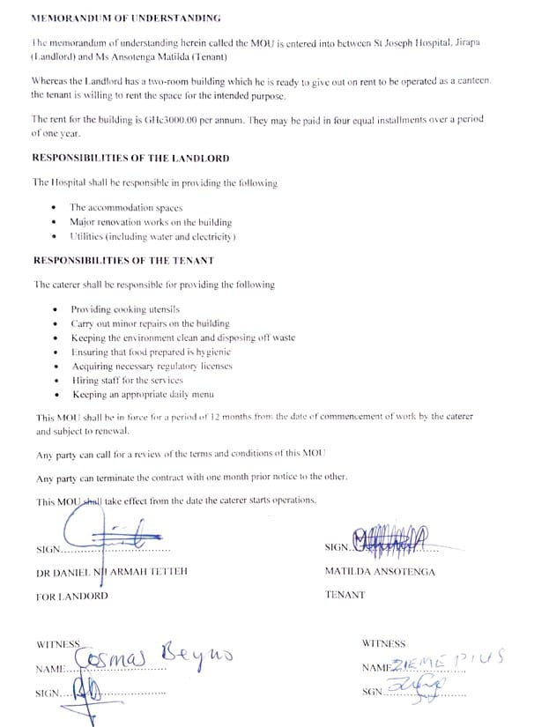
HOSPITAL CANTEEN - MOU

Slide 50
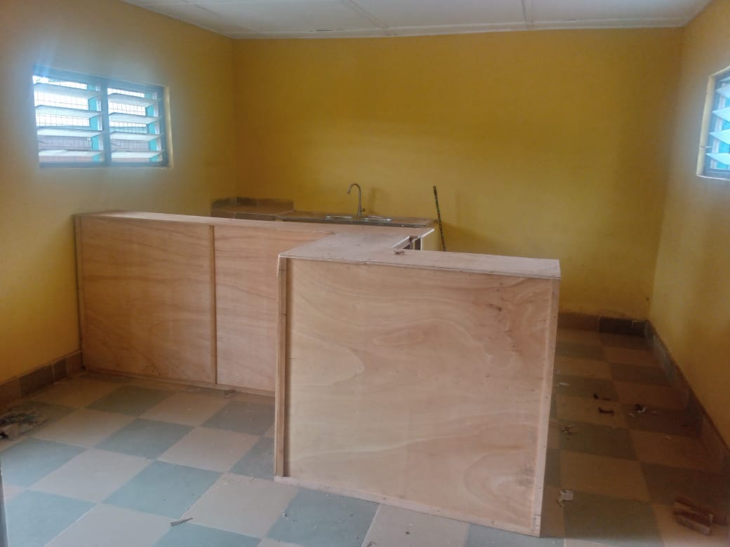
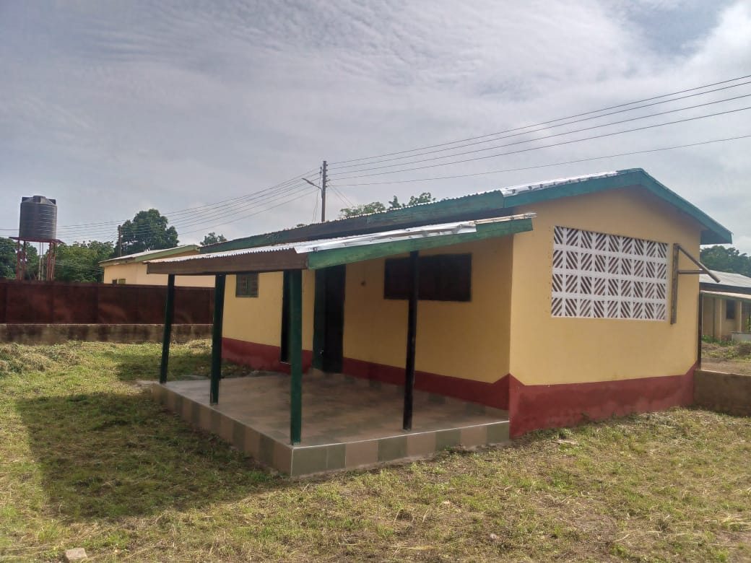
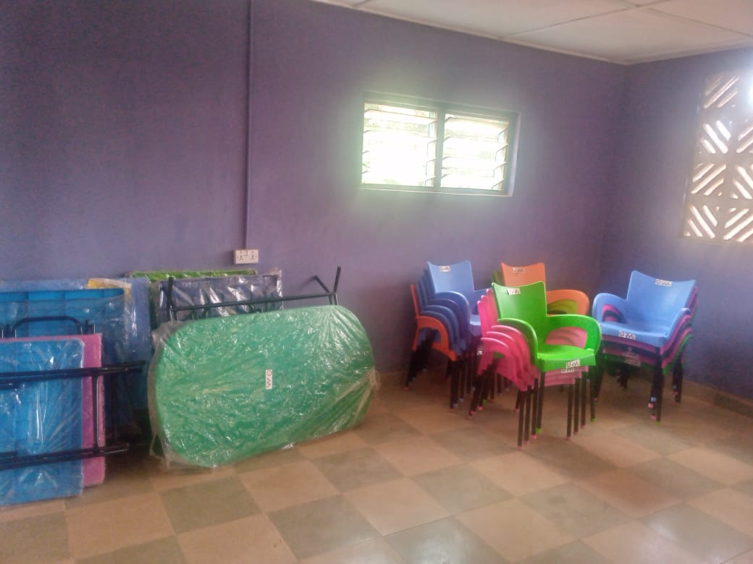
HOSPITAL CANTEEN

Slide 51
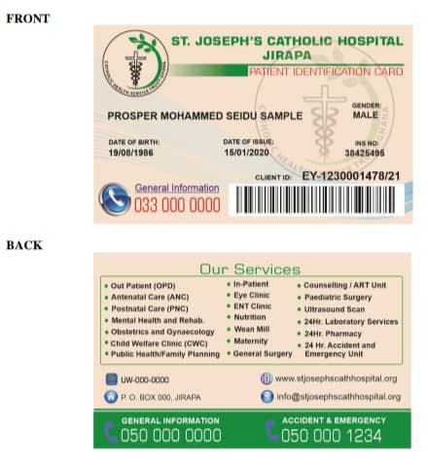
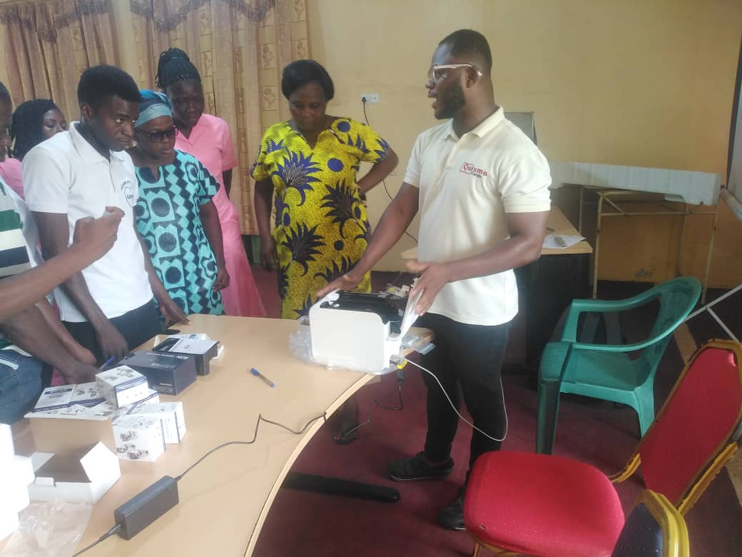
BARCODED PATIENT ID CARD

Slide 52
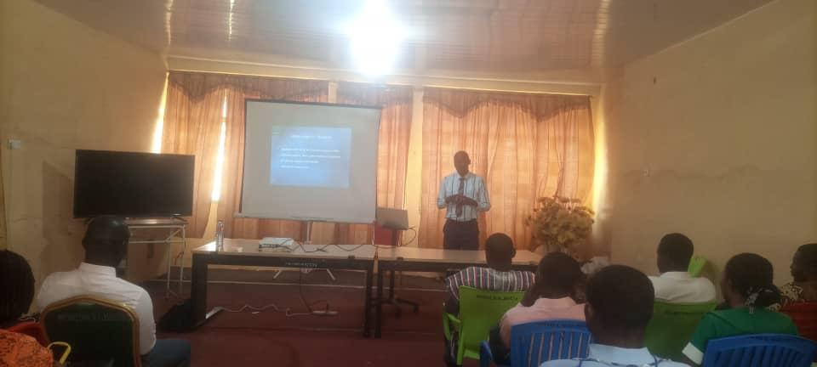
IN-SERVICE TRAINING –
BLOOD TRANSFUSION ETHICS

Slide 53
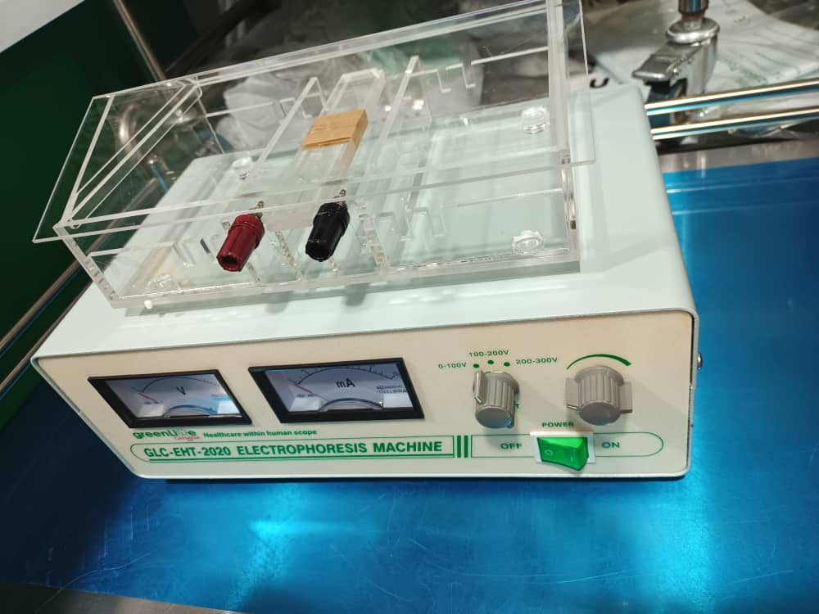
HB ELECTROPHORESIS MACHINE

Slide 54
BAREKA!!!

